Slide 1
Data Preparation

Slide 2
Data Preparation
Business
Understanding
Data
Understanding
Data
Preparation
Data
Deployment
Modeling
Evaluation

Slide 3
The objectives of this stage
In this stage, we use all the knowledge that we gathered during business and data understanding, and prepare a data set for modeling.
The data set should integrate all the data sources.
It should be clean and curated.
It should contain data in a standard format.
It should not include redundant or non-required features.

Slide 4
What do we do in this stage
Data integration
Handling missing values and outliers
Feature transformation
Data reduction
Sampling

Slide 5
What do we do in this stage
Data integration
Handling missing values and outliers
Feature transformation
Data reduction
Sampling

Slide 6
Data integration
Data integration is a relatively technical task.
It is important to create a one flat file, with all the features contained in it.
Pre-define a single granularity level.
Sometimes the flat file utilizes data from external sources (e.g., weather data, economic data, etc.).

Slide 7
Data integration
The prepared data set should be in a form that we expect to obtain later on, in production (if you will not have it in production, there is no reason to prepare it).
QA, QA, QA

Slide 8
What do we do in this stage
Data integration
Handling missing values and outliers
Feature transformation
Data reduction
Sampling

Slide 9
Handling missing values and outliers
Consideration:
What is the reason for the missing values? Does it indicate on an error, or is it a normal business phenomena?
Does the missing values represent something?
Per feature: what is the proportion of missing values?
Correlation between missing values in different features – does it mean anything?
How important is the feature with the missing values?
Can the missing values be inferred somehow?

Slide 10
Handling missing values and outliers
Code the missing values with a special value (e.g., “unknown”)
Suitable when having a missing value implies something on the data
Not suitable with numeric features
Code missing values with a new variable, and somehow complete the missing values in the original variable
Suitable when the missing value say something and the feature is numeric
Ignore records that contain missing values
Suitable when missing values are relatively rare
Ignore features that have high rate of missing values
But what if the feature is highly important?
Fill in the missing values

Slide 11
Filling in missing values
A global constant:
For categorical features it may be the mode
For numeric features it may be the mean or the median
A constant which is dependent on the values of other features
Sampling: fill in the missing values using a random sample from the same feature
Potentially duplicate records
Use some machine learning algorithm (first complete the missing value and then use the completed value for prediction)

Slide 12
Handling outliers
Handle outliers with great care. Outliers often contain valuable information:
Expose a systematic failure in the collection system
Show us that there is something that we didn’t understand well
Demonstrate some extreme cases
Try not to leave surprising outliers unexplained
Do you expect outliers to occur in future cases? If you do, handling them must be carried out in an automatic way.

Slide 13
Handling outliers
How to handle detected outliers:
If it is an error: usually delete it and treat as if it is a missing value
If possible, fix it
If it is an extreme case, adjust these values in order to avoid undesired biases in the model (normalization)

Slide 14
What do we do in this stage
Data integration
Handling missing values and outliers
Feature transformation
Data reduction
Sampling

Slide 15
Data normalization
Normalization means re-scaling the features
Why do we need it?
By re-scaling each feature to a common range, we can compare distances in different features.
In some machine learning algorithms, the operations simply doesn’t make sense without normalization.
Machine learning algorithm usually rely on optimization techniques. Having a set of scaled features is a good practice for performing optimization.
Minimizing the impact of extreme cases
Example:
Compare two real-estate alternatives in terms of their living room size (squared meters) and number of bedrooms.

Slide 16
Common normalization methods
Linear normalization (to the range of [0,1] or [-1,1]
The most simple approach
Outliers before the normalization will remain outliers after it
Log normalization
Suitable to log-normal distribution (and similar).
It reduce the long-tail effect, which tends to bias many algorithms
Z-scoring
Transform to the number of standard deviations from the mean

Slide 17
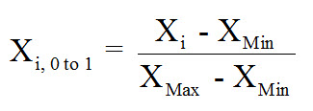
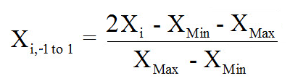
Linear normalization

Slide 18
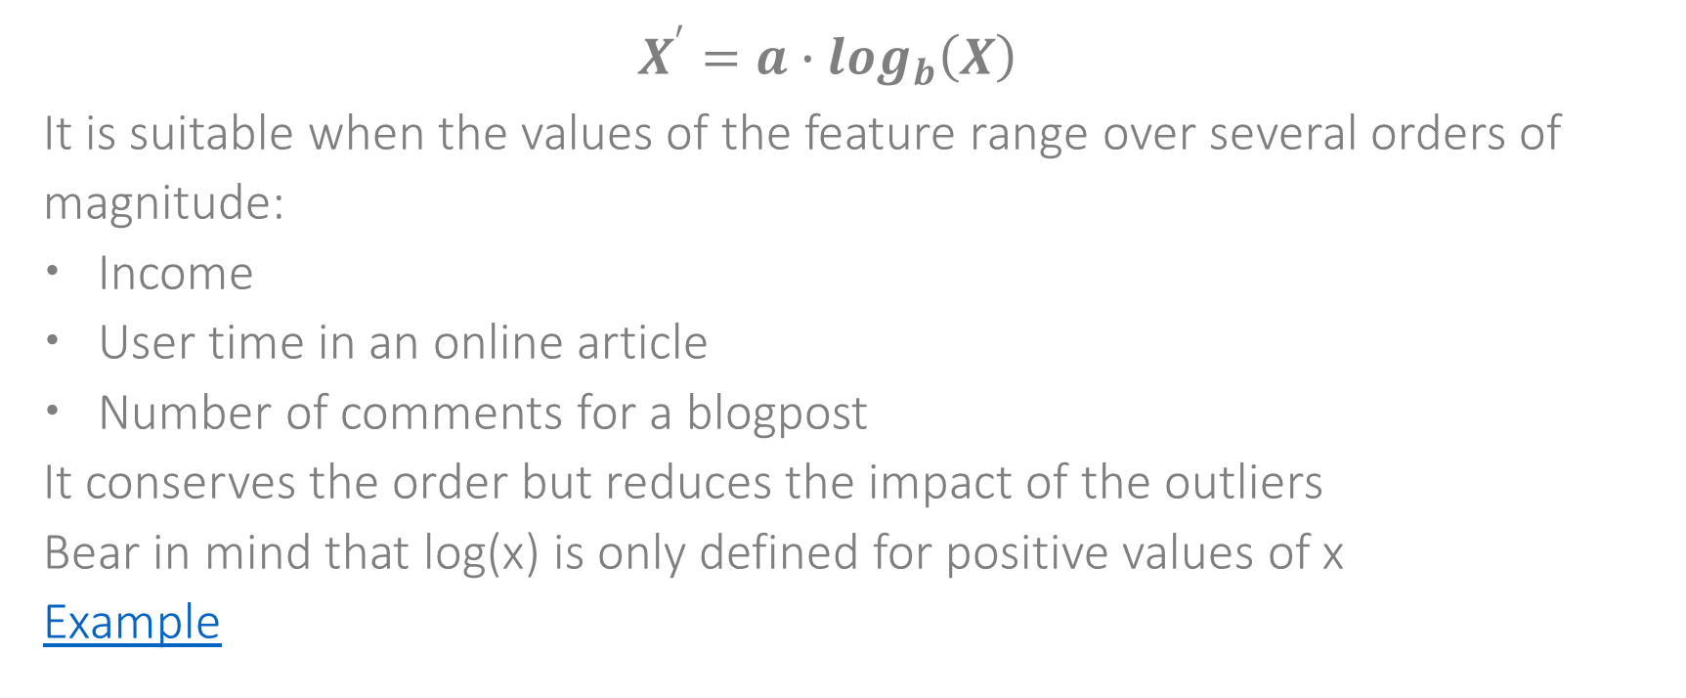
Log normalization
$$X^{′}=a∙\log_{b}\left(X\right)$$
It is suitable when the values of the feature range over several orders of magnitude:
Income
User time in an online article
Number of comments for a blogpost
It conserves the order but reduces the impact of the outliers
Bear in mind that log(x) is only defined for positive values of x
Example

Slide 19
Data discretization
Why do we need to discretize the data?
It is not a very common operation
Some algorithms only run on discrete data (MI, Naïve Bayes)
It is sometimes easier to see intervals than it is to see the numeric values (e.g., age groups vs. exact age). Specifically, when we want a model not only to predict. But also to provide insights.

Slide 20
Data discretization methods
Three common approaches:
Equal-width
Equal-frequency
Entropy based

Slide 21
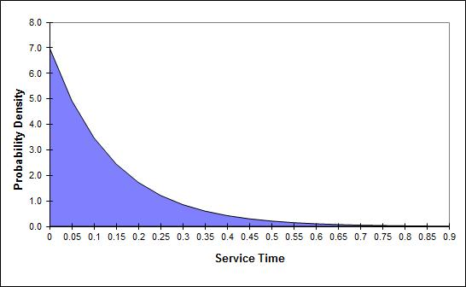
Equal width vs. equal frequency

Slide 22
Equal width vs. equal frequency
Equal width emphasizes the numeric value itself.
Outliers will occupy very small bins.
Typically, more suitable to relatively uniformly distributed features.
Equal frequency emphasizes the ordering of the numeric value, and not the numeric value itself.
It eliminate the impact of outliers (which is only described by the width of each bin).
Example: income percentiles

Slide 23
Entropy based discretization
It is typically implemented as part of an algorithm (e.g., decision tree).
Take a numeric variable, and search for the discretization that will help that variable to maximize the mutual information with the class label.

Slide 24
Dummy variables / variables encoding
Motivation:
The major part of machine learning algorithms use mathematical functions that can only be applied on numeric features.
6.2 * X_{i} means nothing if X_{i} is not a number.

Slide 25
Dummy variables / variables encoding
Encoded variables provide one way of using categorical variable as part of a numeric formula. There might be many options for doing that. We will discuss two:
Dummy variables / one-hot encoding
Target-value based encoding

Slide 26
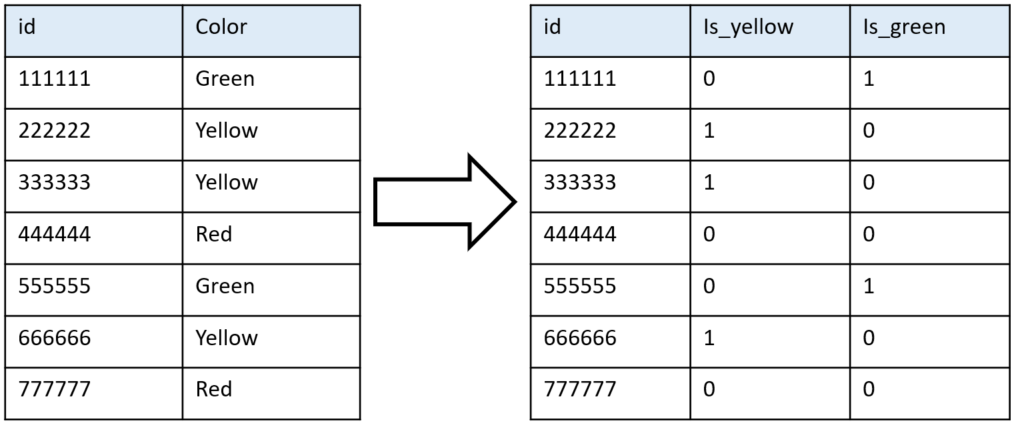
One-hot encoding

Slide 27
Target-value based encoding
Example:
When predicting the expected revenue of an online advertisement spot, the user’s country is an important explaining variable (advertises are willing to pay way more for users from the U.S. than for users from Peru.
The problem: “country” is a discrete variable with near 200 possible values. Creating dummy variables might be feasible, but it will increase the dimensionality of the training set, significantly.

Slide 28
Target-value based encoding
Example:
One usable way out: define a new variable that will represent the average (or median) revenue per user, broken down by country. The result will be a single numeric variable that often describe the impact of the country quit well.

Slide 29
What do we do in this stage
Data integration
Handling missing values and outliers
Feature transformation
Data reduction
Sampling

Slide 30
Data reduction
The more complexity you add to the model, the better it can fit to the training data.
This is not always a good practice!
High dimensional data means a more complex model
In this step we are searching for a compact representation of the training set.
A good representation will maintain the important patterns that are in the original training set, and will remove redundancies and non-important information

Slide 31
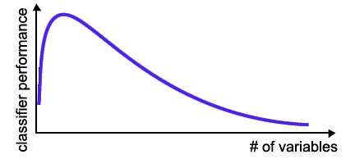
Model generalized performance

Slide 32
The motivation to data reduction:
Attaining a better fitted model (better generalized accuracy)
Attaining better computation (simpler models are faster to train, and easier to predict with)
Attaining better understanding on the key features that affect the target
Sometimes features are hard to extract

Slide 33
Data reduction
And yet, it depends on the algorithm that we are using.
Some algorithms are more prone to overfitting than others.

Slide 34
Data reduction
Two main approaches for dimensionality reduction:
Feature selection - Selecting a subset of the input features, without any transformation
Feature reduction - Transform the input features into a new space with lower dimensionality

Slide 35
Feature selection
The objective is to select a subset of the explaining features which contain the majority of information about the outcome.
Important notion: the number of available subsets is exponential in the number of training features.
Finding the optimal set of explaining feature is a NP-Hard problem that we cannot solve. Feature selection techniques are heuristic.

Slide 36
Feature selection approaches
Filter methods
Wrapper methods
Embedded methods

Slide 37
Filter methods
In filter methods we select features independent of the learning algorithm
Set of all the features
Some filter method
Subset of the features
Training on the subset
Model

Slide 38
Filter methods
Univariate feature selection
Select those explaining features that have the strongest relationships with the target feature:
Correlations (numeric variables)
Chi square (categorial)
Mutual information

Slide 39
Filter methods
Univariate feature selection
This is a very naïve method. It is more appropriate for finding important features that it is for optimizing a subset of explaining features.

Slide 40
Filter methods
Manual exploration
A correlation heatmap is a helpful tool.
The basic idea: correlated explaining features might be redundant. Features that are correlated with the target feature are probably important.

Slide 41
Filter methods
MRMR
(Maximum Relevance Minimum Redundancy)
This is actually a family of methods which select one feature at a time and combines between:
Relevance: the relationship between a new feature and the target
Redundancy: the relationships of the new feature and features that were already selected

Slide 42
Wrapper methods
Wrapper methods select the features according to their impact on the actual performance of the model.
Generate a subset
Subset of the features
Set of all the features
Train model on the subset
Model
Evaluate

Slide 43
Wrapper methods
In principle, there are 2^{n} combinations of feature subsets:
It cannot be managed computationally
It is highly prune to overfitting
So one need to apply some search heuristic (e.g., stepwise, forwards or backwards)

Slide 44
Embedded methods
Embedded methods are part of some learning algorithms (e.g., the decision-trees family).
It is possible to use the internal feature selection mechanism of some algorithms in order to extract a selected subset of features.
We will see some examples later on.

Slide 45
Feature reduction
The number of explaining features can be reduced not necessarily through feature selection.
In some dimensionality reduction methods we are actually projecting the input space into a different space and select features in the projected space.

Slide 46
PCA
Project the data to a set of orthogonal dimensions (which are linear combinations of the original dimensions)
Objective: make each new dimension to contain as much variance as possible
Typically only the first k < n new dimensions are used
It is a filter method (it is independent from any learning algorithm, and actually it is independent from the target).

Slide 47
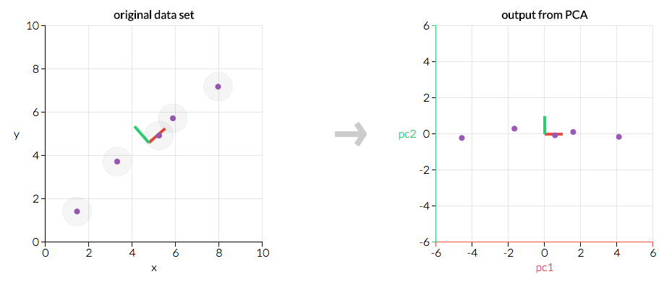
PCA

Slide 48
PCA

Slide 49
Autoencoders
Autoencoders refer to a series of methods that decode the information of the input features, in a significantly lower dimensionality, in a way that will allow reconstructing them
A common technique is to use an autoencoder ANN.

Slide 50
What do we do in this stage
Data integration
Handling missing values and outliers
Feature transformation
Data reduction
Sampling

Slide 51
Sampling
Sampling may be helpful in several cases:
Data is too big: billions of data points with just few explaining features
Data is unbalanced (usually rare positive cases).
Focus on specific timeframe which seems to be relevant.
Both under sampling and over sampling might be used.

Slide 52
Sampling
Sampling approaches:
Simple random sampling – usually this the choice when we want to reduce the number of data points.
Every X observations
Stratified sampling:
Partition the dataset into separate groups, and draw the sample with different probabilities from the different groups

Slide 53
Data Preparation

Slide 54
Homework
Hands on machine learning requires a lot of practice!
It is assumed to be your responsibility.
In order to practice you need data:
Use data that you know from your work (priority 1)
Search for a data set that you find to be interesting (try Kaggle, UCI machine learning repository and more)
If you can’t find an interesting dataset, use the Adult data set from UCI machine learning repository

Slide 55
Homework
Get to know the business domain that your data come from (read and explore). What is the machine learning task that you are trying to solve?
Data understanding:
Write down the number of rows and columns
Manually explore few records
Write down the names of the explaining features. For each feature, write down its data type. Does the data types align with your expectations?
Can you see any redundant or unusable feature?
Extract descriptive statistics for each and every feature. Could you find any missing values? Any outliers?
How would you treat these missing values and outliers
If you are solving supervised learning, what features seem to be explaining?
Do you have any ideas for feature engineering?

Slide 56
Homework
Data preparation:
Missing values: for each feature that contain missing values, decide on the most suitable way to treat these values and implement it.
Outliers: if there are outliers, decide how to handle them, and implement it.
Normalize the numeric features. What is the most appropriate normalization method for each feature?
Discretize all the numeric features (do not override the original numeric values) and calculate the mutual information with the target. Weight the features according to the mutual information measure.
Run PCA and plot the cumulative percent of the explained variance versus the number of principle components. Do you have any idea on how to add the categorical features to that analysis?
Without overriding the original dataset, use sampling in order to generate a new dataset, in which the number of instances for each target value is identical.

